Slide 1
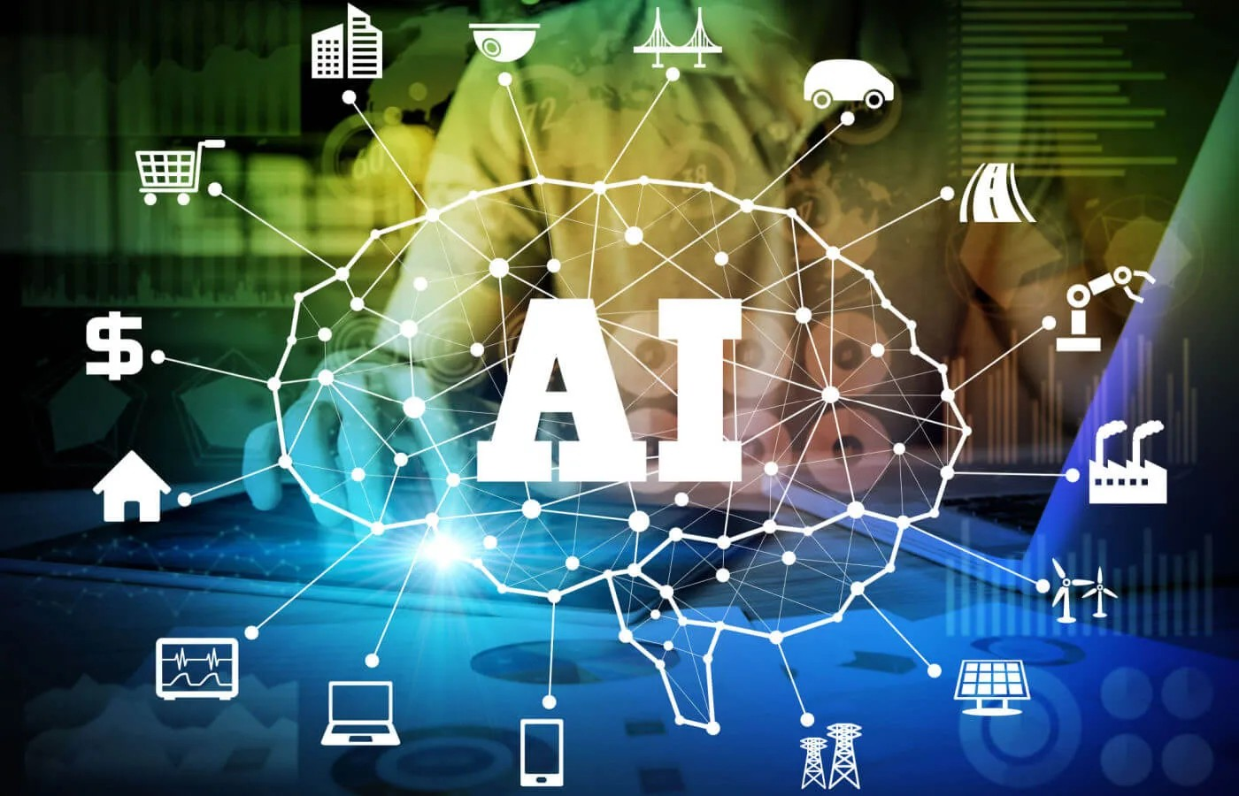
Introduction to Artificial Intelligence
AI is a cutting-edge area of computer science
It focuses on replicating human cognitive capabilities
Empowers machines to interpret data, identify trends, and make autonomous decisions
Its integration across sectors is transforming problem-solving and solution implementation
It introduces new challenges in maintaining ethical standards

Slide 2
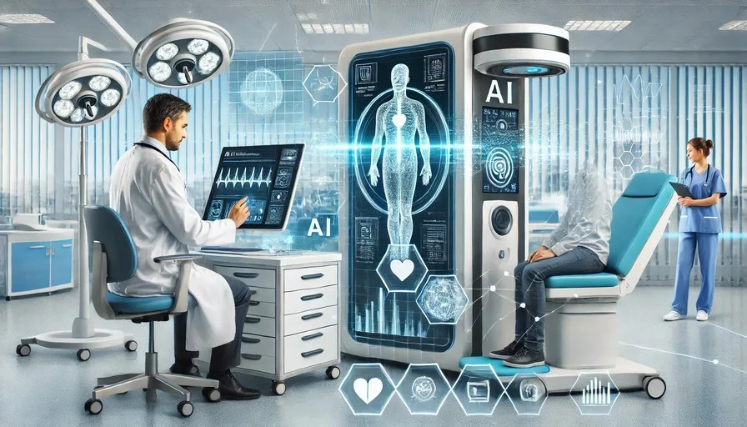
AI Revolutionizing Healthcare
AI enhances patient care, streamlines operations, and improves diagnostic accuracy
AI tools support healthcare professionals by offering decision-making insights
AI applications extend to medical imaging and robotic surgery
AI-driven predictive analytics are used to anticipate patient needs

Slide 3
Challenges in AI Healthcare Integration
Integrating AI into healthcare presents challenges
These include data privacy concerns and the need for robust regulatory frameworks
There is an ongoing requirement for human oversight to interpret AI outputs responsibly

Slide 4
AI Applications Across Domains
AI has diverse applications across various domains
Each domain presents unique benefits and challenges
The key applications, benefits, and challenges are detailed in the table below

Slide 5
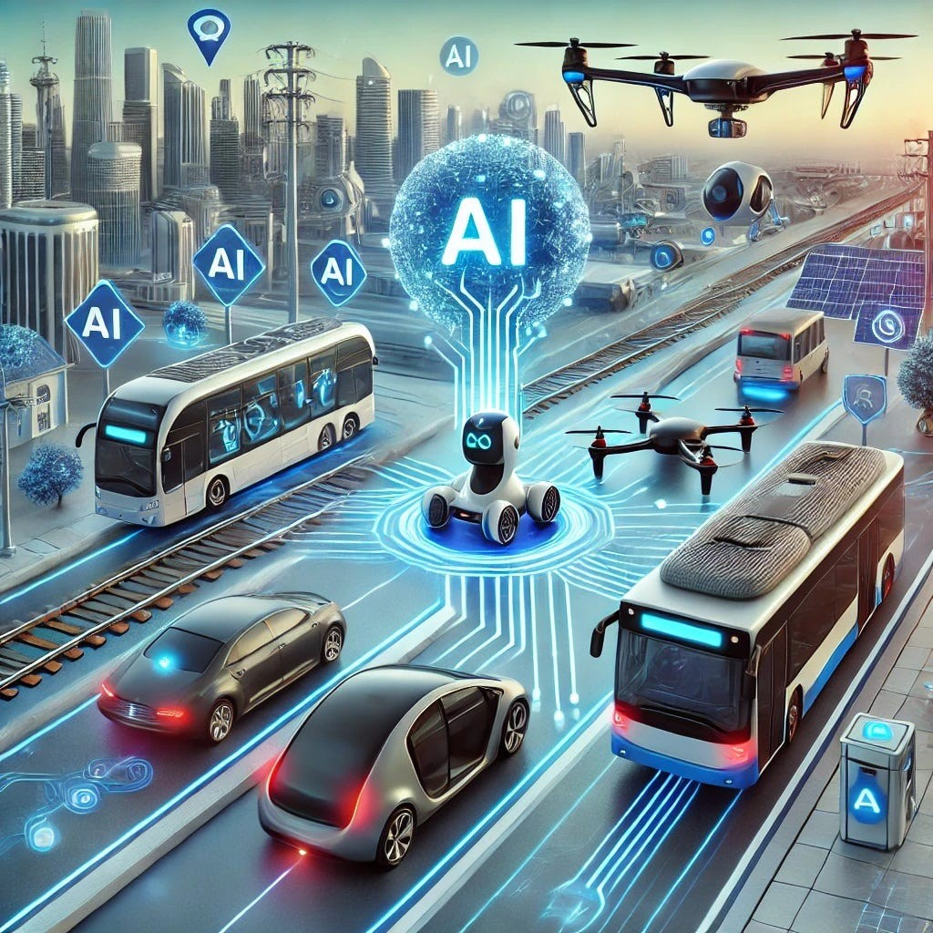
AI's Impact on Transportation
AI is transforming transportation for safety, efficiency, and sustainability
Machine learning optimizes routes and reduces congestion
Autonomous vehicles minimize human error and improve road safety
AI assists in public transit scheduling, demand forecasting, and route planning

Slide 6
AI in Logistics and Supply Chain
AI-driven predictive analytics benefit logistics and supply chain operations
AI helps streamline deliveries and reduce operational costs
AI integration is crucial for smarter cities and reduced carbon emissions
Challenges include regulatory hurdles, cybersecurity concerns, and public trust

Slide 7
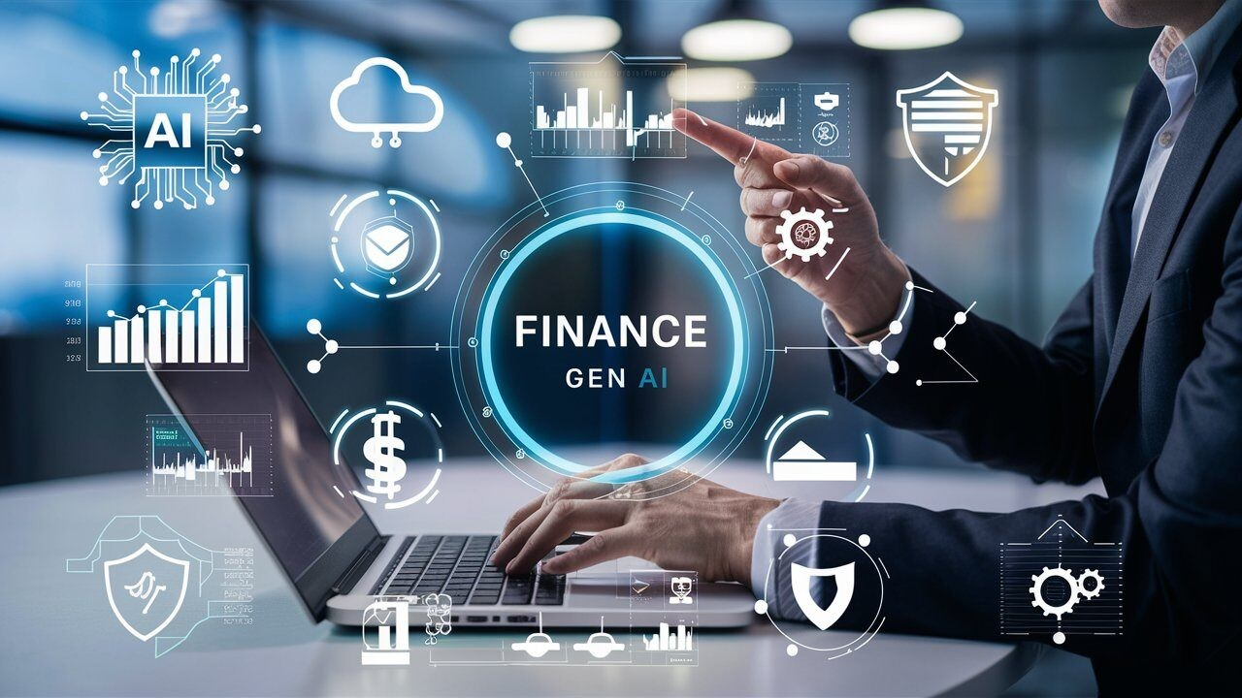
AI's Role in Finance
AI revolutionizes finance with advanced analytical tools and automation
Machine learning enables accurate predictions of market trends and investment opportunities
AI enhances fraud detection and maintains regulatory compliance
AI-powered platforms facilitate personalized banking experiences and streamline customer interactions

Slide 8
AI in Algorithmic Trading
Algorithmic trading is a prominent application of AI
Rapid processing speeds allow for swift execution of trades
AI reduces operational costs and improves efficiency
Ethical concerns, data privacy issues, and algorithmic biases need to be addressed

Slide 9
AI Transforming Education
AI is creating personalized, efficient, and accessible learning experiences
AI-powered tools adapt to individual learning styles and paces
Intelligent tutoring systems provide real-time feedback and support outside the classroom
AI helps identify at-risk students early by analyzing performance data

Slide 10
Benefits of AI in Education
AI offers tailored content through adaptive learning platforms
Enhances understanding and retention of students
Educators benefit from automated grading and administrative assistance
Enables timely intervention for at-risk students

Slide 11
AI Making Education Inclusive
AI-powered language translation and speech recognition tools make education more inclusive
Beneficial for students with diverse linguistic backgrounds
Helpful for students with special needs
Allows educators to focus more on teaching and student engagement

Slide 12
AI Across Domains
Domain | Key Applications | Benefits | Challenges
Healthcare | Early disease diagnosis, personalized treatment, medical imaging, robotic surgery | Improved accuracy, efficiency, patient outcomes, and resource allocation | Data privacy, regulatory requirements, need for human oversight
Education | Adaptive learning, intelligent tutoring, automated grading, performance analytics | Personalized learning, increased accessibility, early intervention, administrative support | Data ethics, equitable access, over-reliance on technology
Transportation | Autonomous vehicles, route optimization, public transit planning, logistics AI | Enhanced safety, reduced congestion, cost-efficiency, smarter cities | Regulatory hurdles, cybersecurity, public trust
Finance | Fraud detection, algorithmic trading, personalized banking, risk management | Real-time insights, improved customer service, efficiency, fraud prevention | Algorithmic bias, ethical concerns, data protection, regulatory compliance

Slide 13
Thank You!
We appreciate your attention. Looking forward to your questions!

